Slide 1

The Billing Process
Periods, Orders and Process Review

Slide 2

Purpose & Goals
TO pass on and share knowledge regarding the functionality of the billing process
For you to gain a solid understanding of the billing process in order to better analyze potential solutions or problems
For you to know what, how To use, and where to find the different functionalities associated with the billing process

Slide 3
Billing Process Period
Part 1

Slide 4
Billing Process Period
What Is It?
The billing process determines how often invoices are generated from purchase orders.
The billing process is scheduled to run at a pre-determined interval (monthly, weekly, daily).
This interval is known as the billing process period.

Slide 5
Billing Process Period
Why do we need it?
the system needs to know when to trigger the billing process
The system needs to know how far ahead it should ‘see’ or look for active purchase orders
Notes:
Point 1:
Without the Billing Process Period, jBilling would have no idea when, or how often it should trigger the billing process.
Point 2:
The Billing Process Period also tells the system how far into the future it needs to look for active purchase orders.
The connection between the Billing Process Period and Purchase Orders will be further explained in Part 2 of this training session.

Slide 6
Billing Process Period
How does it work?
configuration > billing process: you need to set the ‘Billing Period’ field.
typically will want to set the billing period to the shortest purchase order period
Notes:
Before we begin discussing how the Billing Process Period works, it is important to understand that there are two types of periods in jBilling. One of them is being covered in this section of the training. The other is the purchase order period.
The difference between the two is that the purchase order period determines when a purchase order will be generated into an invoice. You can have different purchase orders with different periods (monthly, and daily, and weekly, etc). The Billing Process Period determines how often the billing process runs, and if a purchase order falls on a date that the Billing Process Period ‘sees’ then an invoice will be generated. You can only have ONE Billing Process Period (Monthly, OR, Weekly, OR Daily, OR, etc). We will look at the connection between these two periods in the next section. At this point, you should just know that there are two types of periods that we will be discussing.
Point 1:
Show students where to find this in the system. Configuration > Billing Process: Billing Period
You can set the Billing Process Period to any length of time combination: weekly, annually, daily, which you can select from the dropdown menu. You can also enter in the value.
For example:
‘2’ and ‘Week’ would mean that the Billing Process Period is 2 weeks. OR ‘1’ and ‘Month’ would mean that the Billing Process Period is 1 month.
This is the length of time into the future that the system is going to look for active purchase orders. Again, this will be explained further in the next section.
Point 2:
It is important to know that the Billing Process Period has nothing to do with when a purchase order appears on an invoice. It has everything to do with how often invoices are generated.
Typically, when determining the Billing Process Period, you will want to set it to the shortest purchase order period. The reason for this is that in most cases, you don’t want to prevent future recurring charges on the invoice. (For an example, show the next slide).

Slide 7
Billing Process Period
Example:
Billing Process Period: Month
JAN 1
FEB 1
Purchase Order Period: Week
Jan 1 - 7
Jan 7 - 14
Jan 15 - 21
Jan 22 - 28
Jan 29 – Feb 4
Notes:
For Example:
You have a weekly purchase order, and a monthly billing process. When the billing process runs, it looks ahead from the 1st to the last of the month. Therefore, you would end up with 5 periods for the weekly purchase order on one invoice when you only want one period.
(Click on the slide so that the example appears. The billing process period is Jan 1 – 31. Because the billing process period is looking ahead for active purchase orders, it sees the weekly purchase order. Because it is a weekly purchase order, it recurs on Jan 1, Jan 7, Jan 15, Jan 22 and Jan 29. Instead of getting 1 period on the single invoice that is generated, you would see all 5, and the total for all 5.)

Slide 8
Orders Involved
Part 2

Slide 9
Orders Involved
What Is It?
Purchase orders are required in order for the billing process to know which products to generate invoices for.
The purchase order period Determines how often the products on the purchase order will be generated into an invoice.
if the billing Process Period ‘sees’ a purchase order, it will be generated into an invoice.
Remember: The billing process period does not determine how often the purchase order is generated into an invoice. It is the purchase order period that determines this!

Slide 10
Orders Involved
Why do we need it?
Purchase order period:
lets the system know how often the order should be charged in an invoice
Notes:
Without the purchase order period, the system has no way to identify how often you want to charge the customer for the products. The purchase order period can be any length of time (you can configure this in Configuration > Order Period)

Slide 11
Orders Involved
How does it work?
Customer Charged until: January 31
Active Since: January 1
Total for the PERIOD: $500.00
Purchase Order Period: MONTHLY
Active Since: January 1
Next Period: January 8
Next Period: January 15
Next Period: January 22
Purchase Order Period: WEEKLY
Total for the PERIOD: $500.00
Total for the PERIOD: $500.00
Total for the PERIOD: $500.00
Notes:
By setting the Purchase Order period, you are telling the system what the length of time the charges (products added to the purchase order) should be billed for. You can have as many purchase order periods as required. For example: Monthly, Daily, Weekly, bi-weekly, Annually, 5 years. Basically if you can think up the period of time, you can create it. (Again in Configuration > Order Periods)
(CLICK TO VIEW THE FOLLOWING EXAMPLES:)
Monthly Example:
The period is captured for the entire month – January 1 -31. This is the period that will appear on your invoice. The customer will be charged for $500 for the period of January 1-31. This means on February 1, the purchase order starts a new period. February 1 – 29. Again, on the invoice, there would be a charge for these products for the period of February 1 – 29, for $500.
Weekly Example:
The period is only captured for a week. The product cost is the same. The first period is January 1 – 7. On the invoice, the system is going to generate a line for the period of January 1 – 7, for $500. This means that on the 8, the same thing will occur. It will appear on an invoice for the period of 8 – 14, for $500. (and so on).
You can see that although the products have the same total, they are charged at different intervals. This is due to setting the purchase order period.
The purchase order period works along side the billing process. As briefly shown in the ‘how does it work?’ section of the Billing Process Period, if the Billing Process Period ‘Sees’ a purchase order because the purchase order PERIOD falls within the Billing Process Period, then the system will generate an invoice for it.

Slide 12
Orders Involved
How does it work?
purchase orders are generated into invoices based on whether or not the Billing Process Period ‘sees’ the purchase order
You can have multiple orders on a single invoice. These purchase orders must have periods that the billing process Period ‘sees’.
Notes:
By setting the Purchase Order period, you are telling the system what the length of time the charges (products added to the purchase order) should be billed for. You can have as many purchase order periods as required. For example: Monthly, Daily, Weekly, bi-weekly, Annually, 5 years. Basically if you can think up the period of time, you can create it. (Again in Configuration > Order Periods)
The purchase order period works along side the billing process. As briefly shown in the ‘how does it work?’ section of the Billing Process Period, if the Billing Process Period ‘Sees’ a purchase order because the purchase order PERIOD falls within the Billing Process Period, then the system will generate an invoice for it.

Slide 13
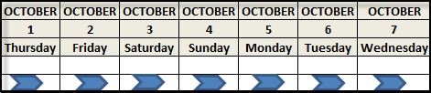
Orders Involved
Example 1:
weekly billing process period ‘sees’ ahead 7 days
monthly pre-paid purchase order for customer Brian smith (Active since: oct. 1)
Notes:
This is a very simple example.
Here we have a diagram of a WEEKLY billing process period. This means that every seven days, the billing process is going to run. This also means that the Billing Process Period will be looking ahead seven days, for any ACTIVE purchase orders that fall within that period.
We have a monthly pre-paid purchase order for our customer Brian Smith. The purchase order has yet to be generated into a purchase order – it has an active since date of October 1.
Typically, customers will have more than one purchase order, with varying purchase order periods, however this is a simple example so we are only going to look at one purchase order for now.

Slide 14
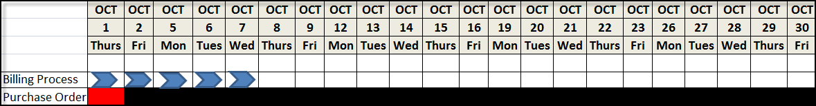
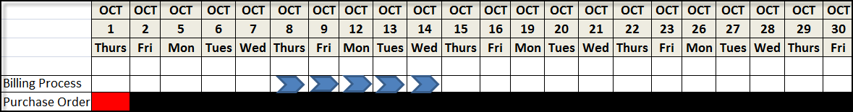
Orders Involved
Example 1:
Notes:
Ask the students to explain/describe the result they see based on the diagram.
Answer:
The billing process period looks for all purchase orders that fall within the October 1 – 7 dates. Because the monthly purchase order has never been generated before, the active since date tells us when the billing process period will see this purchase order: October 1. Because the billing process period sees this purchase order, it is going to generate it into an invoice for the period of October 1 – 31.
Ask the students what the next date that the billing process period will see from and until? (answer: October 8 – 14)
Ask the students what will happen with the purchase order? (answer: nothing. No invoice will be generated because the period from October 1 -31 has already been billed. The billing process period does not ‘see’ the purchase order anymore.
(CLICK ON THE SCREEN TO REVEAL THE IMAGE FOR THE AN

Slide 15
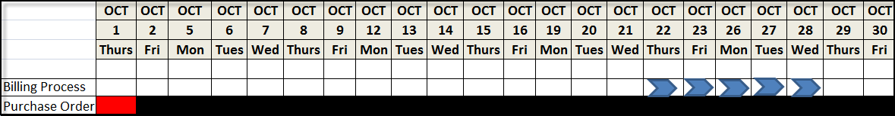
Orders Involved
Example 1:
Notes:
The billing process period runs again from the 22 – 28. Nothing is generated.
Ask the students: when the billing process period runs again, which dates will it run for? (answer: October 29 – November 4)
Ask the students: will this billing process period generate an invoice? If so why? (answer: yes. The next time purchase order period is from February 1 – 29, and the billing process period ‘sees’ from October 29 – November 4. November 1 is a date within that time.)
Ask the students: what will the purchase order period be on the invoice? (answer: November 1 – 30)

Slide 16
Orders Involved
Example 2:
Notes:
We are going to add a bi-weekly order, starting on Januar y4. The bi-weekly purchase order is recurring.
On January 1, the weekly billing process runs, but this time it finds two purchase orders that fall within its time range. It finds the monthly purchase order, and the bi-weekly purchase order. The monthly purchase order will generate onto an invoice with a period from January 1 - 31. The bi-weekly order will generate onto the same invoice with a period from January 4 - 17.

Slide 17
Orders Involved
Example 3:
Jan 1
Feb 1
Mar 1
Apr 1
Monthly Plan Purchase Order
ANSWER:
Purchase Order Period: Monthly
Type: Pre-Paid
Active Since: Jan 13
Cycle Start: Feb 1
Next Run Date: Feb 1
Billing Period: Monthly
Feb 1 - 29
January 13: customer signs up for the monthly plan.
Invoice Must show:
Pro-rated period for January 13 – 31 (charged in arrears)
Following month period for February 1 – 29 (Charged In advance)
Notes:
Let’s make the scenario a little more complicated.
Scenario:
I work for a company called, Embridge United.
A customer signs up for a plan on Jan 13. Their first invoice must be charged for the period of Jan 13 – 31 in arrears, and the following month, Feb 1 -29 in full. How do we achieve this?
Ask the students: How do you think we can achieve this? (Have students work together to come up with an idea for a solution).
Answer:
Monthly purchase order period for the purchase order with the plan. The type must be pre-paid so that you can get the following month invoiced in full. Active since = Jan 13 (that’s the date the service started on). Cycle start date should be Feb 1 because you want to include the 2 periods in the invoice. Next run date should be Feb 1: you will bill Jan in arrears (after January has finished) and February in advance. Billing period = monthly (could really be a different length of time, depending on other orders).

Slide 18
Orders Involved
Example 3:
Jan 1
Feb 1
Mar 1
Apr 1
Monthly Plan Purchase Order: Paid Immediately
ANSWER:
Purchase Order Period: Monthly
Type: Pre-Paid
Active Since: Jan 1
Next Run Date: Feb 1
Billing Period: Monthly
Feb 1 - 29
January 1: customer signs up for the monthly plan which they must pay for in advance.
Invoice Must show:
February plan period
All one-time purchase orders made in January
Notes:
Let’s make the scenario a little more complicated.
Scenario:
I work for a company called, Embridge United.
A customer will signs up for a monthly plan January 1. This plan needs to be paid immediately. Next month’s invoice must include the plan, charged in advance for the month of February, and also include all one-time purchase orders that were made in January.
Ask the students: How do you think we can achieve this? (Have students work together to come up with an idea for a solution).
Answer: Demonstrate this in jBilling
Monthly purchase order period (it’s a monthly plan). It’s pre-paid because you want to charge for the month of February, even though it hasn’t passed yet. Active Since: Jan 1 (that’s the date the plan begins on), Next run date = Feb 1, very similar to previous example except you’ve already paid for the month of January (in advance, rather than pro-rated in arrears). Therefore, you still want to pay in advance for the following month. All January one-time purchase orders – linked to recurring order (require recurring order field selected in configuration > billing process), plus billing wants to keep everything up to date. Even though they are in January, they will show up in February’s invoice.

Slide 19
Configuration
Next Run date, Billing Period
Days to Review Report
Number of retries; Number of days between retries
Due date
Require recurring Order; Use process date for invoices
Apply Overpayments to invoice (Automatic Payment Processing)
Maximum periods to invoice
Notes:
Next run date - This is the date when the billing process is scheduled to run.
Generate review report - This flag indicates to the system that it needs to run a preview of the billing process before the real process takes place, and invoices are sent to your customers
Days to Review Report - How many days before the real billing process do you want the Review Report to be generated
Number of retries – Used when automatic payment processing is selected. Determines how many payment attempts to do.
Number of days between retries - How many days you wish to have in between payment retries
Billing Period - When the billing process takes place, the system looks ahead for the period of time specified during the configuration of the system.
Due date - The Due Date is the period of time your customers are given to pay their invoice before it becomes overdue (can be overridden on customer and order level)
Require recurring order - If this box is checked, the system will generate an invoice for a customer only if there is at least one recurring Purchase Order included in the invoice
Use process date for invoices – All invoices generated will be created with the same date as the billing process
Apply overpayment to invoices - By using this option, the system will automatically link new invoices to payments that have some balance left
Maximum periods to invoice - This parameter sets a limit on how many periods from a purchase order will be included in an invoice. It applies only to recurring purchase order

Slide 20
Review Report
Part 3

Slide 21
Review Report
What Is It?
a pretend billing run that will generate review invoices. The review report will not send invoices, or collect payments from your customers.

Slide 22
Review Report
Why do we need it?
Prevents incorrect invoices from being charged or sent to your customers
Saves time and prevents the hassle of trying to correct invoices after they have been automatically paid or sent to a customer
Enables you to review the invoices to ensure that they are correct before they are sent to your customers
if you find mistakes they can be easily corrected before the billing process runs
Notes:
The main reason you should generate a review report is that once an official billing process has run, there is no way to easily set back the clock (so to speak) to regenerate incorrect information. Aside from that fact, if you are using automatic payment methods, once the official billing process runs, those payments are deducted from a customer’s credit card or bank. As you can imagine, once these payments are deducted, a customer will not be pleased if the amount is incorrect. There is no way for the system to correct this other than creating credit PO’s for all the customers who require one. This is very time consuming and is not an efficient use of your time.
It is due to the reasons listed above that you should highly recommend to all of jBilling’s clients that they use this functionality for the first few months of using the system. After they have ensured that their billing is running as expected, (after a few billing runs), then they can turn the functionality off (by deselecting the ‘Generate Review Report’ field).
By using the review report, you can easily correct mistakes before your customers see them (meaning, before the official billing process runs).

Slide 23
Review Report
How does it work?
configuration > Billing Process: select the ‘generate review report’ checkbox and enter a number into the ‘Days to review report’ field
Two ways to generate a review report: Automatically & Manually
Three Stages: Neutral, disapprove and approve
if the review report is not approved by the next run date, the billing will not run as scheduled.
Notes:
Point 1:
When a review report is generated, the invoices that you will see is what the system will be sending out to your customers when the billing process officially runs. An important thing to remember is that you set the number of days before the billing process runs, that you want to generate the review report. If you set that field to a number of days that is too far from the actual billing run (20 for example), there is a good chance that you will not see some of the invoices you were expecting. The reason for this is that, in the remaining days before the billing process is set to run, purchase orders are still being created. In most situations, you want to have the review report generate as close to the next run date as possible (1 day for example).
Again, this functionality can also be used for a period of time, and then turned off, or visa versa.
Point 2:
There are two ways to generate a review report: Automatically (which means that you let the system take care of triggering the generation of the review report), or Manually (which means you trigger the review report to generate). I am going to show you how to do this in the system right now. (CHANGE TO JBILLING – note: if there already is a review report you need to make sure that it is disapproved before moving forward with this example).
Click on Configuration > Billing Process. From here, click on the ‘Run Billing’ button. Since we have selected the ‘Generate Review Report’ checkbox, the system will know to generate a review report. If it is not selected, the system will proceed with a regular billing – which is not what we want to do at this point. You will know that the billing run has been successful when you see 2 validation messages. One will be green, and will let you know that the billing process has been triggered to run. The other will show a warning message, and state that the billing process is currently running. This second validation is important because it lets you know that the system is actually processing the billing. If only the green validation message appears, you will know that nothing has happened. The billing hasn’t ‘run’.
Once you see these two validation messages, click on the Billing tab. Here you will see your review report listed. You will know that it is a review report because the text will be displayed in italics. An official billing run will have regular text. At this point, you have successfully manually generated a review report.
It is important to note that if the system were to automatically generate a report (based on the ‘days to review report’ field), the review report would appear in the list, the text in italics as well.
Point 3:
There are three stages that the report needs to move through in order for your billing to run on time. The three stages are: Neutral, Approved and Disapproved.
Neutral:
This means that the review report has been generated, but nothing has been done with it yet. It is just sitting in the Billing list, waiting for you to complete your review. (Show the example: you have just completed a generation of a review report. This report is in the neutral stage because nothing has been done with it yet).
Disapprove:
This means that you have reviewed the invoices that have been generated, and have found error(s). To disapprove the report, click on the ‘Disapprove’ button. This gives you 24 hours to complete the changes before the system will automatically generate another review report (if you don’t complete the changes, the system will generate the same report, plus any additional PO’s that were created within that time). If you want the review report immediately, simply follow the steps for manually triggering the billing process (click on the ‘Run Billing’ button).
Once you have disapproved the report, the errors will need to be fixed in the purchase orders or on the customer information screen. Do not try to delete the invoice because they are the result of the PO and other information. The invoice also doesn’t actually exist yet – it is just a review. Again, once the changes are made, you can wait 24 hours, or manually re-generate the review report.
(JBILLING – show an example of disapproving the review report by clicking on the appropriate button. Show that the status of the report is now ‘Disapproved’ Make a change to a purchase order by adding a product with a quantity of 2. Then manually trigger the billing to run, and show that the review report now shows the updated information).
Approve:
This stage means that all the information generated by the review report is correct, and you want the official billing process to run.
Based on our example, we have checked to see that our changes were picked up by the review report. They were, and now everything is correct. Because everything is correct, you should click on the ‘Approve’ button. This lets the system know that the billing should run as scheduled (on the next run date).
Again, you have two options, you can wait for the next run date, and have the official billing run on that date, or you can go back into configuration and manually trigger the official billing process to run.
Point 4:
It is important to note that if the review report is not approved by the next run date (the date that the billing process is set to automatically run on), it will not run. This means that if your billing is set to run on January 1, and the review report has not been approved, your customers will not receive their invoices, and automatic payments will not be made.
This could be helpful in situations where a client may need an alternate method for holding their billing, but still running it from a particular date.
Example: billing run should take place on March 1, but information (mediation for example) is not all collected until the 6th of March. It is possible to hold the review report and approve it on March 6. The billing from March 1 would then run.

Slide 24
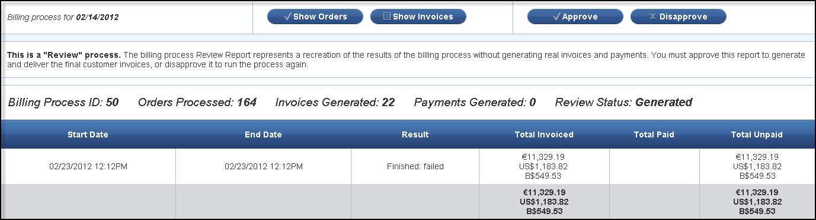
Review Report
Group Recap:
Notes:
Group Scenario Review – Students should be able to identify which stages the report is in, as well as the steps they need to take to move the review report through the three stages.
Questions to ask Students (click on the screen for animation to reveal the buttons they need to click)
What stages is this review report in? (answer: Neutral)
What steps should be taken? (answer: You need to review the invoices to ensure all information is correct)
What if there is an incorrect invoice? (answer: Click the disapprove button. You need to find the purchase order and edit it, or create a purchase order, etc.)
What are the two choices you have after you correct what needs correction? (answer: 1. manually generate the report. 2. Wait 24 hours)
You have manually generated another review report. All the information is now correct. What do you do? (answer: click the approve button)
What happens after you click the approve button? (answer: the billing process will run as scheduled.)

Slide 25
Technical overview
Part 4
Notes:
This section describes the technical overview of the billing process and plug-ins it includes

Slide 26
Technical Overview
Plug-ins involved:
Billingprocesstask – Billing scheduler
IBillingProcessFilterTask– Filter the billable customers
- BasicBillingProcessFilterTask
- BillableUsersBillingProcessFilterTask
- BillableUserOrdersBillingProcessFilterTask
Orderfiltertask – filter the customer’s orders
- Basicorderfiltertask
- orderfilteranticipatedtask
Notes:
BillingProcessTask – schedule the billing process using Quartz
IBillingProcessFilterTask – filter the billable customers :
BasicBillingProcessFilterTask – All active customers
BillableUsersBillingProcessFilterTask - All active customers with orders
BillableUserOrdersBillingProcessFilterTask - All active customers who have orders that are billable
OrderFilterTask– filters the customer’s orders:
BasicOrderFilterTask - Verifies if the order should be included in a process considering its active range date. Consider billing period type for this.
OrderFilterAnticipatedTask – Extends the billing “sees period by the anticipated periods.”

Slide 27
Technical Overview
Plug-ins involved:
orderperiodtask – calculates the billable order period that goes into an invoice
- BasicOrderPeriodTask
- OrderPeriodAnticipateTask
- ProRateOrderPeriodTask
InvoiceFilterTask– apply overdue invoices (invoice delegation)
- NoInvoiceFilterTask
- BasicInvoiceFilterTask
- NegativeBalanceInvoiceFilterTask
Notes:
OrderPeriodTask – calculated the start and end date of an order that goes into an invoice
BasicOrderPeriodTask – Get order periods based on the billing process period
OrderPeriodAnticipateTask – Extends the view limit of the order by anticipated value
ProRateOrderPeriodTask – Overrides the end date calculation of the order period

Slide 28
Technical Overview
Plug-ins involved:
InvoiceCompositionTask – Compose the invoice calculates the invoice lines
- BasicCompositionTask
- DailyProRateCompositionTask
- SimpleTaxCompositionTask
- CountryTaxCompositionTask
- PaymentTermPenaltyTask
- CalculateDueDate
- CalculateDueDateDfFm
Notes:
InvoiceCompositionTask – calculates the invoice lines
BasicCompositionTask–
DailyProRateCompositionTask–
SimpleTaxCompositionTask–
CountryTaxCompositionTask
PaymentTermPenaltyTask
CalculateDueDate
CalculateDueDateDfFm

Slide 29
Technical Overview
Database tables involved:
billing_process
process_run
process_run_total
process_run_user
Order_process – the most important !
Notes:
Billing_process_configuration – stored the billing configuration per entity
Billing_process – list of billing processes
Process_run – billing process status run (start end date, payment date)
Process_run_total – total invoiced amount
Process_run_user – billing processes per users with run status
Order_process – order periods involved in the invoice per billing process

Slide 30
New billing process
Part 5
Notes:
This section describes the new billing process that was introduced in jBilling 3.2

Slide 31
New Billing Process
Changes:
Billing period is now customer wide, not company wide
remove cycle start date from orders
Billingprocesstask scheduler is used to determined the next run date
Remove main subscription orders
resolving current order for the mediation is based on customer’s billing period (main subscription)

Slide 32
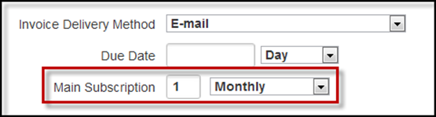
New Billing Process
Billing Period:
The Billing Period has been removed from the 'Billing Process' Configuration screen, and moved to the Customer Information screen. This field is now labeled as: 'Main Subscription'.
Pro-rating:
the main subscription takes the place of the Cycle Start date field
Notes:
The customer is going to be billed on the 1st of the month, every month.
Purchase Orders with a 'Next Invoice' that falls on a date between the 1 - 31 for a month will be generated into an invoice

Slide 33
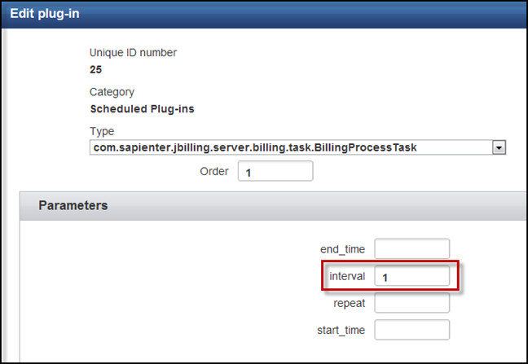
New Billing Process
Scheduled Plugin:
Billingprocesstask scheduler defines the next run date increment on each successful billing process run. Interval is specified in hours
Notes:
The Next Run Date field on the billing process configuration screen will still move forward. This has not changed. However, the period of time it moves forward is now based on what you have set up in the scheduled Plug-In.
All the scheduled plug-in does, is tell the system when to trigger the billing process. Via the Next Run Date field, you can then view when the next time the Billing Process is scheduled to run.
- You can increase the interval to run less often. For example, if you wanted to run the Billing Process every day, you would set the interval to: 24. This means that the Billing Process would run every day. This also means that the Next Run Date would then change from June 1 to June 2.
If you wanted to run the Billing Process every month, you would set the interval to: 720. This means that the Billing Process would run every month. In this example, the Next Run Date would move from June 1, to July 1.

Slide 34
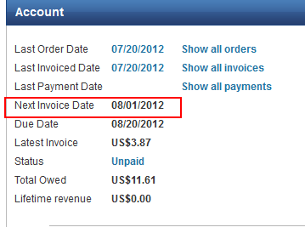
New Billing Process
Customer billing selection:
only customers with next_invoice_date <= next run date are included in the billing process
NEXT_INVOICE_DATE is calculated in UserBl.getNExtInvoiceDate()
Notes:
-

Slide 35
Resources:
Billing process:
Http://jbilling.com/files/documentation/user_guide.pdf
- Chapter 4 Billing process
New Billing process:
enterprise/master user guide – Chapter 4 Billing process
- 1.5.14 alternative billing process
Notes:
-

